Slide 1
Mrs. Dalloway: A Modernist Masterpiece

Slide 2
Introduction
Virginia Woolf's Life
Plot Summary
Character Analysis: Clarissa Dalloway
Character Analysis: Septimus Smith
Themes
Symbolism
Writing Style
Relevance Today
Conclusion

Slide 3
Introduction
Welcome, everyone. Today we will be exploring the world of Virginia Woolf's Mrs Dalloway. This novel is a masterpiece of modernist literature, known for its complex characters, intricate plot, and innovative writing style.
Woolf's use of stream of consciousness and shifting perspectives creates a rich tapestry of voices and experiences, drawing the reader into the inner worlds of her characters. Her lyrical prose captures the beauty and complexity of everyday life, while also exploring deep philosophical questions about time, memory, and the human condition.

Slide 4
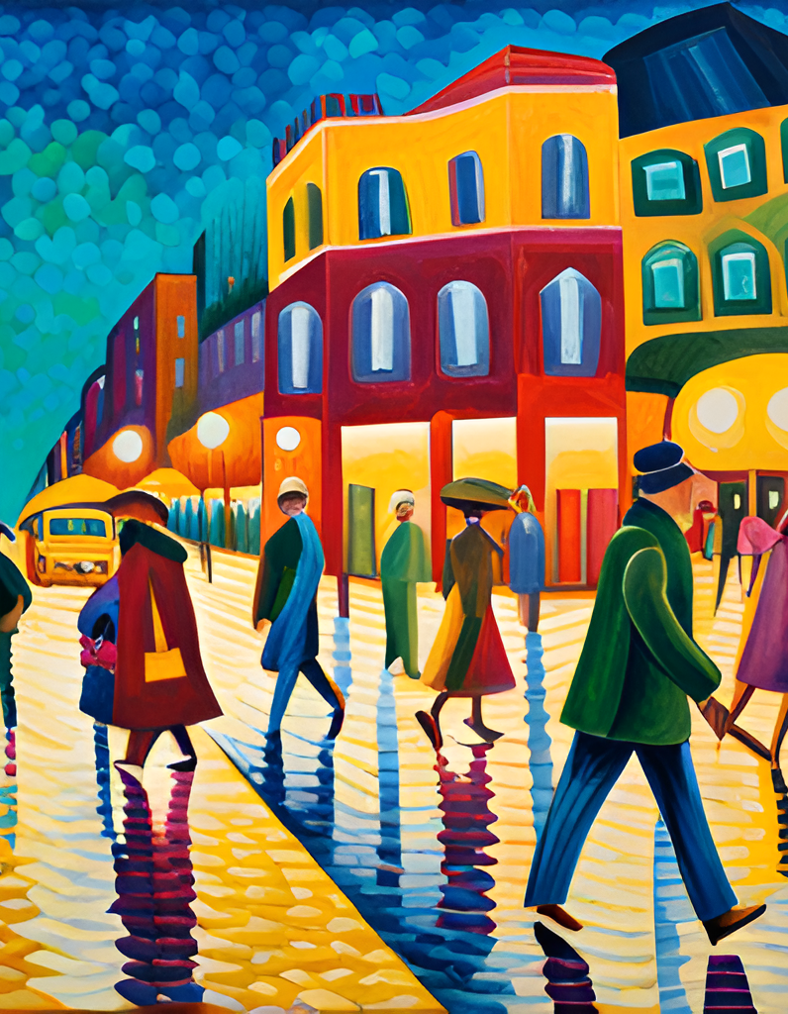
Virginia Woolf's Life
Virginia Woolf was born in London in 1882 to an affluent family. Her parents were both writers and intellectuals, and she grew up surrounded by books and ideas. However, Woolf's childhood was marred by the deaths of several close family members, including her mother when she was just 13 years old. These experiences had a profound impact on her writing, and themes of loss and grief can be seen throughout her work, including in Mrs Dalloway.
Woolf was also a central figure in the Bloomsbury Group, a circle of artists and writers who rejected traditional Victorian values and embraced modernism. This group encouraged experimentation and innovation in literature, and Woolf's writing style reflects this influence. In Mrs Dalloway, for example, Woolf uses stream of consciousness narration and shifts between different characters' perspectives, creating a complex and layered narrative that captures the inner workings of the human mind.

Slide 5
Plot Summary
Mrs Dalloway takes place over the course of a single day in June 1923, as Clarissa Dalloway prepares for a party that evening. The novel weaves together multiple perspectives, following not only Clarissa but also her former lover Peter Walsh, her friend Septimus Smith, and several other characters.
As the day progresses, Clarissa reflects on her life and the choices she has made, while Peter struggles with his unrequited love for her. Meanwhile, Septimus, a war veteran suffering from shell shock, experiences hallucinations and struggles to connect with his wife. The novel explores themes of time, memory, mental illness, and the role of women in society.

Slide 6
Character Analysis: Clarissa Dalloway
Clarissa Dalloway is a complex character whose motivations are not always clear. On the surface, she appears to be the perfect hostess, planning a party with meticulous detail. However, as the story unfolds, we see that there is much more going on beneath the surface. Clarissa is haunted by memories of her past, particularly her relationship with Peter Walsh. She is also struggling with feelings of dissatisfaction with her life, despite her privileged position in society.
One of the most interesting aspects of Clarissa's character is her relationships with other characters in the book. Her interactions with Peter Walsh reveal a great deal about both of their personalities, while her relationship with Sally Seton shows a different side of Clarissa's character. Ultimately, Clarissa's significance to the story lies in her ability to represent the contradictions and complexities of human nature.

Slide 7
Character Analysis: Septimus Smith
Septimus Smith is a complex character in Mrs Dalloway, who serves as a contrast to the more traditional Clarissa Dalloway. As a World War I veteran suffering from shell shock, Septimus struggles with his mental health throughout the novel. His experiences with the war have left him disillusioned and disconnected from society, and his relationship with his wife is strained as a result.
Despite his struggles, however, Septimus is a deeply empathetic character who is able to connect with others on a profound level. His interactions with other characters, particularly Clarissa, reveal a great deal about the nature of human connection and the importance of empathy in modern society. Overall, Septimus serves as a powerful symbol of the effects of war on individuals, and his story is a poignant reminder of the sacrifices made by those who serve their country.

Slide 8
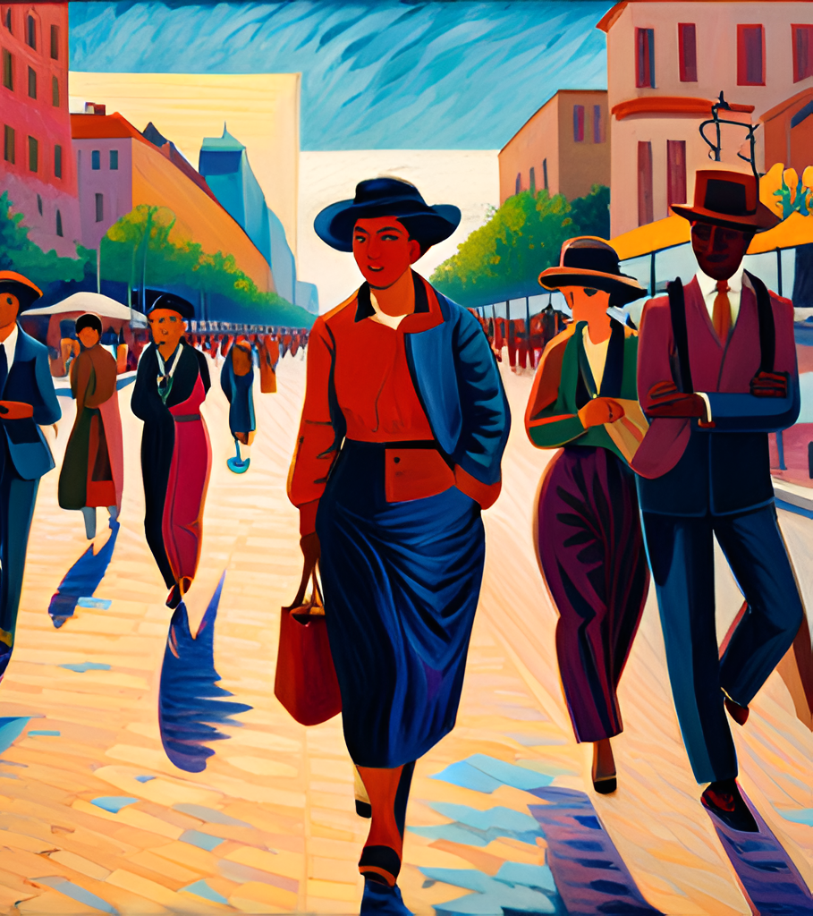
Themes
One of the major themes of Mrs Dalloway is the nature of time. Woolf explores the idea that time is not linear, but rather a fluid and subjective experience. The characters in the novel are constantly shifting between past, present, and future, and the narrative structure reflects this sense of temporal dislocation. Through her use of stream of consciousness and shifting perspectives, Woolf creates a richly layered portrayal of the complexities of human experience.
Another important theme in the novel is the role of women in society. Woolf was a feminist writer who sought to challenge traditional gender roles and stereotypes. Mrs Dalloway is a complex and nuanced portrayal of female experience, exploring issues such as social class, sexuality, and motherhood. The character of Clarissa Dalloway is a particularly powerful example of a woman who struggles to find meaning and purpose in a society that often marginalizes and oppresses women.
Finally, Mrs Dalloway also explores the effects of war on individuals. The novel is set in the aftermath of World War I, and many of the characters are struggling to come to terms with the trauma and loss they have experienced. Septimus Smith, in particular, is deeply affected by his experiences in the war, and his story highlights the devastating impact of violence and conflict on the human psyche.

Slide 9
Symbolism
The use of symbolism in Mrs Dalloway is a key aspect of Virginia Woolf's writing style. The party, for example, represents the superficiality and shallowness of high society, while also highlighting the isolation that Clarissa feels despite being surrounded by people.
The flowers, on the other hand, represent life and vitality, but also the fleeting nature of existence and the inevitability of death. Finally, the sound of Big Ben serves as a reminder of the passage of time, and the way in which it can both oppress and liberate individuals.

Slide 10
Writing Style
Virginia Woolf's writing style in Mrs Dalloway is characterized by her use of stream of consciousness, shifting perspectives, and lyrical prose. Stream of consciousness is a literary technique that allows the reader to experience the character's thoughts and feelings as they occur in real time. Woolf uses this technique to great effect in Mrs Dalloway, allowing the reader to delve into the minds of her characters and experience their innermost thoughts and emotions.
In addition to stream of consciousness, Woolf also employs shifting perspectives throughout the novel. This technique involves switching between different characters' points of view, often within the same paragraph. By doing so, Woolf creates a sense of fluidity and interconnectedness between her characters, while also providing insight into their individual experiences and perspectives. Finally, Woolf's prose is characterized by its lyricism and poetic quality. Her use of language is often rich and evocative, creating vivid imagery and sensory experiences for the reader.

Slide 11
Conclusion
In conclusion, we have explored the life and writing style of Virginia Woolf, analyzed key characters and themes in Mrs Dalloway, and examined the use of symbolism and stream of consciousness in the novel. We have also discussed why this book remains relevant today, resonating with readers across generations.
As Virginia Woolf herself wrote in Mrs Dalloway, "What is this terror? what is this ecstasy?" This quote captures the essence of the novel's exploration of the human experience - the highs and lows, the joys and sorrows, the beauty and terror of life.

Slide 12
Relevance Today
Mrs Dalloway is a novel that continues to resonate with readers today due to its exploration of timeless themes such as the nature of time, the role of women in society, and the effects of war on individuals. Woolf's lyrical prose and use of stream of consciousness also contribute to the novel's enduring appeal.
One of the reasons why Mrs Dalloway remains relevant today is its depiction of the inner lives of its characters. Woolf's use of stream of consciousness allows readers to experience the thoughts and emotions of the characters in a way that feels authentic and relatable. Additionally, the novel's exploration of societal expectations placed on women and the impact of war on individuals continues to be relevant in modern times.

